Slide 1
Submitting your Paper
Submission to a Karger Journal

Slide 2

Steps to follow:
Log in – as an Author
See progress – Author Dashboard
Guidelines – Submission guidelines
Authors – And Co-authors
Details – How to enter Manuscript, Funding, OA Agreement and Pre-print information
Keywords – Add custom keywords
Documents – Choose the files
Reviewers
Letter – Cover letter and accompanying information
Declaration – And submission statement
Send – Submit your manuscript

Slide 3
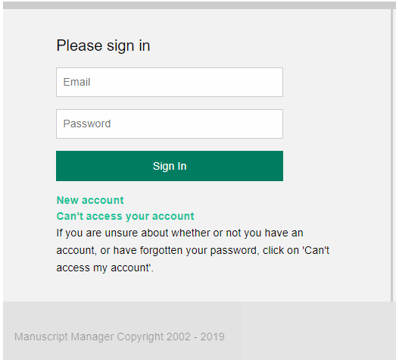
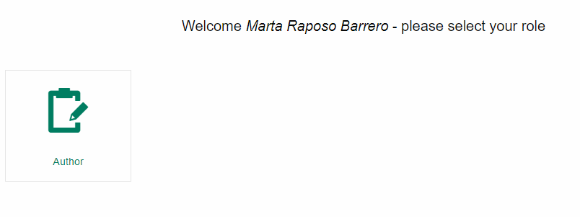
1. Log in – as an Author
If you have an account:
Log in using your Email and Password
Click on “Author”
If you do not have an account:
How to create a new account
https://manuscriptmanager.nickelled.com/author-online-submission?ngroup=link
1
1
2
3
3
2

Slide 4
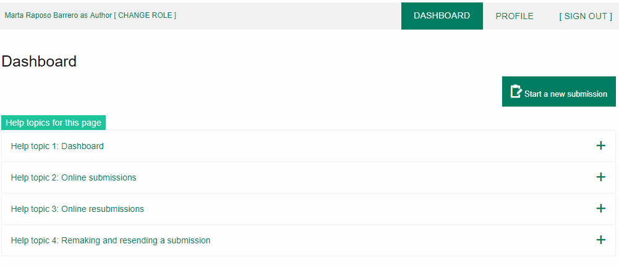
2. See progress – Author Dashboard
Click on:
“Start a new Submission”

Slide 5
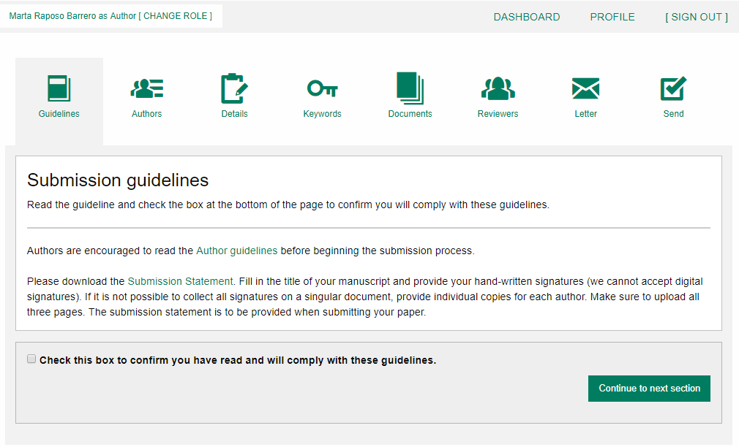
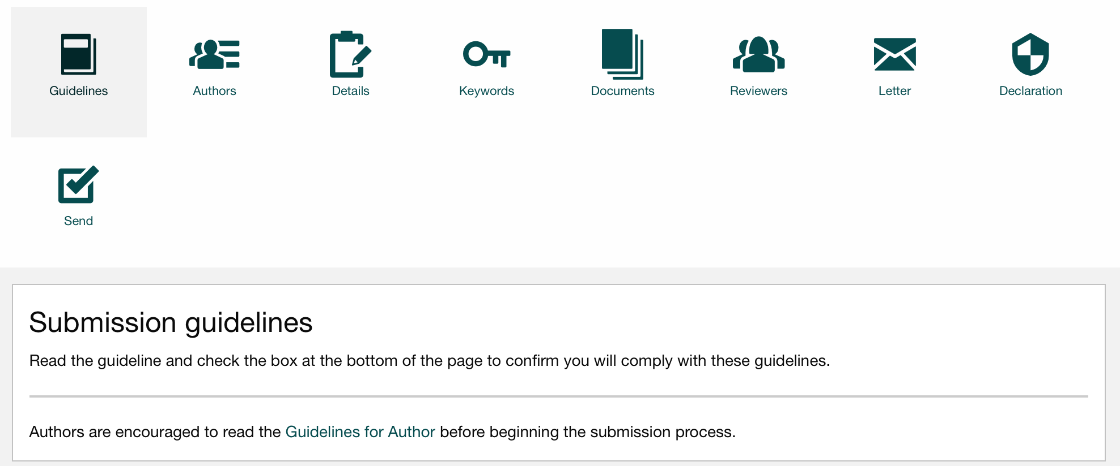
3. Guidelines – Submission guidelines
1
2
Confirm you have read the Guidelines pertinent to the Journal to which you are submitting
Click on “Continue to next section”
1
2

Slide 6
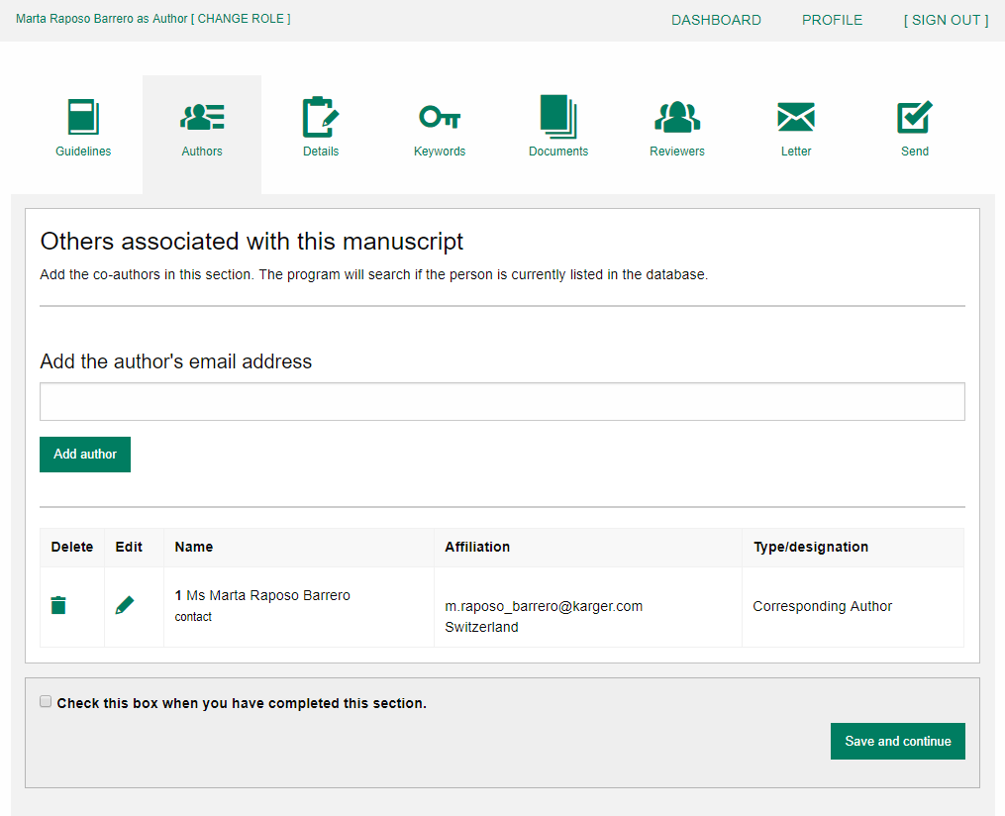
4. Authors – And Co-authors
Add the co-authors one-at-a-time by first entering the co-authors’ email addresses:
If the co-author is already in the database, he/she will appear in the list
If the co-author is not already the database, the submitting author must
add the co-author’s
information
Click on “Add Author”
Check the box when completed
Click on “Save and Continue”
1
1
a.lorenz@karger.com
2
2
3
4
3
4

Slide 7
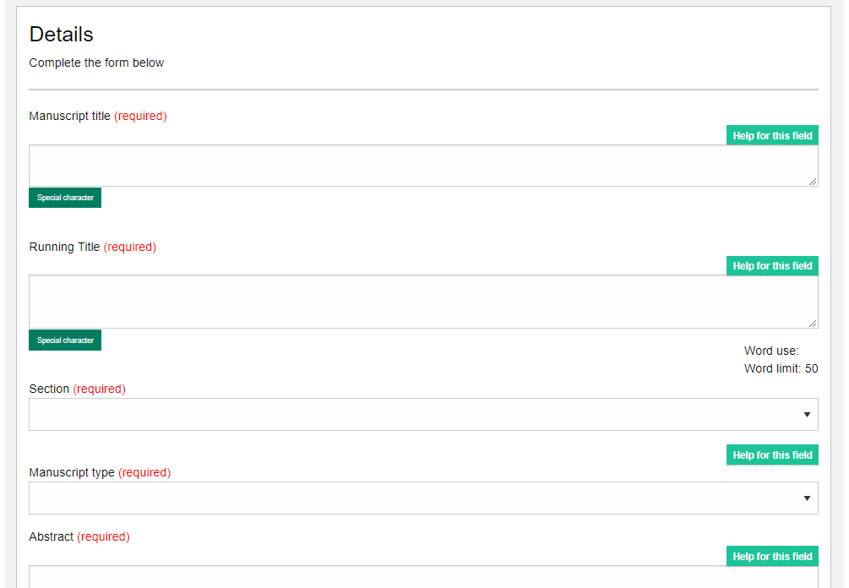
5. Details – How to enter Manuscript Information
Select the appropriate Section of the journal for your manuscript:
Open the drop-down menu and select the section most suited to your submission. This may well be None
Make sure to select the right Manuscript type by opening the drop-down menu
Please check the journal’s Guidelines for more information
1
2
1
2

Slide 8
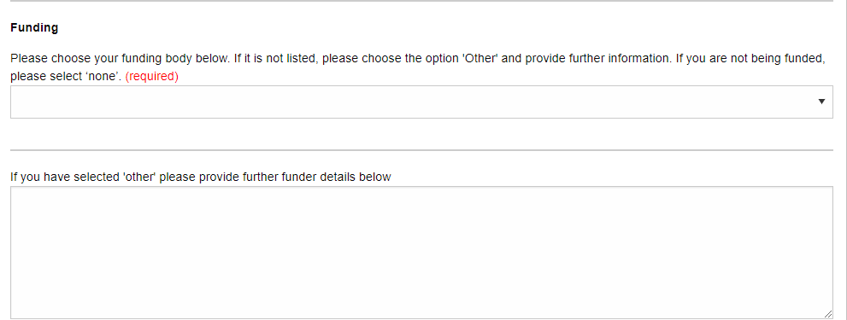
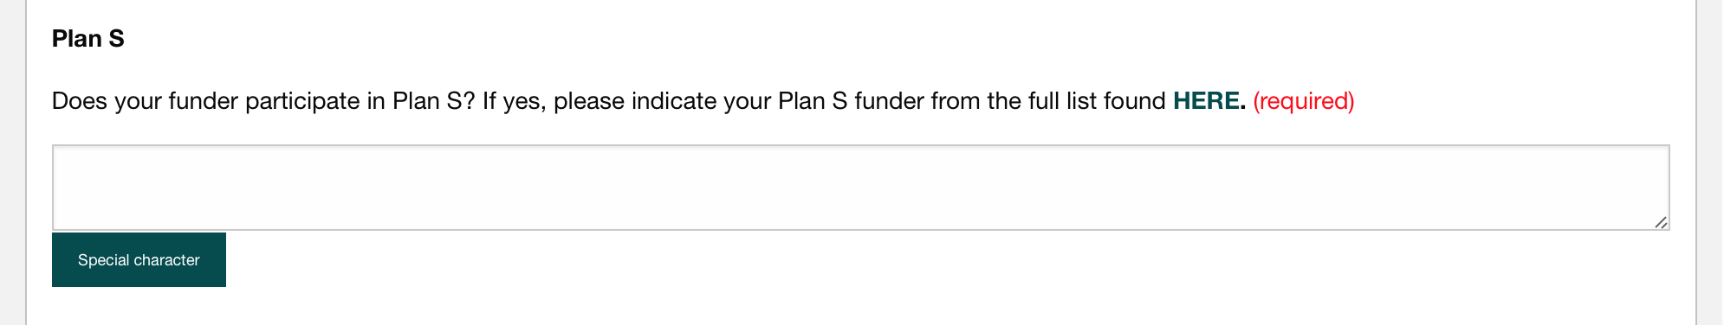
5. Details – Enter funding and Plan S information
You will be asked to select your funding body or state None here
- If you choose the option ‘other’ please provide further information in this field.
Additionally, you will also be asked to indicate your Plan S funder or state None here

Slide 9
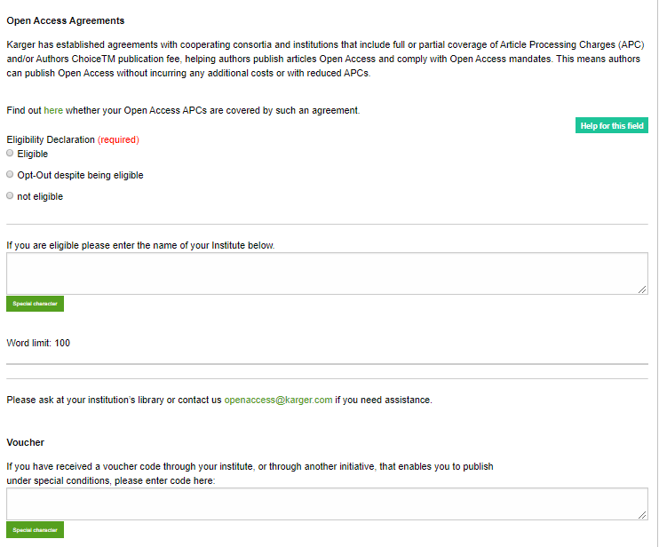
5. Details – Open Access Agreements
You will be asked to specify whether your institute has an Open Access Agreement with Karger. All entries will be checked and verified upon acceptance of the paper
- For information regarding the Open Access Agreements you can follow the link in the submission field. See print screen on next slide
If the agreement comes with a specific voucher, please provide details here
1
1
2
2

Slide 10
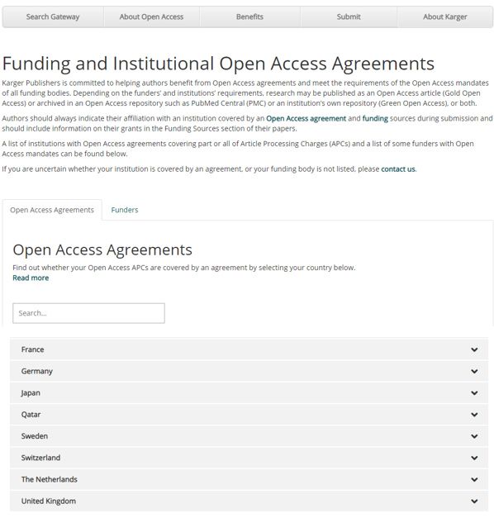
5. Details on Open Access Agreements on our website

Slide 11
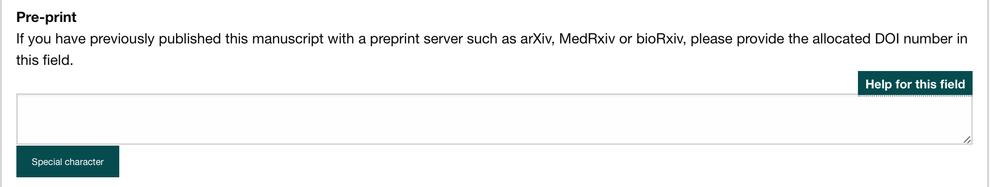
5. Details – Pre-print
You will be asked to indicate whether you have previously published this manuscript with a preprint server

Slide 12
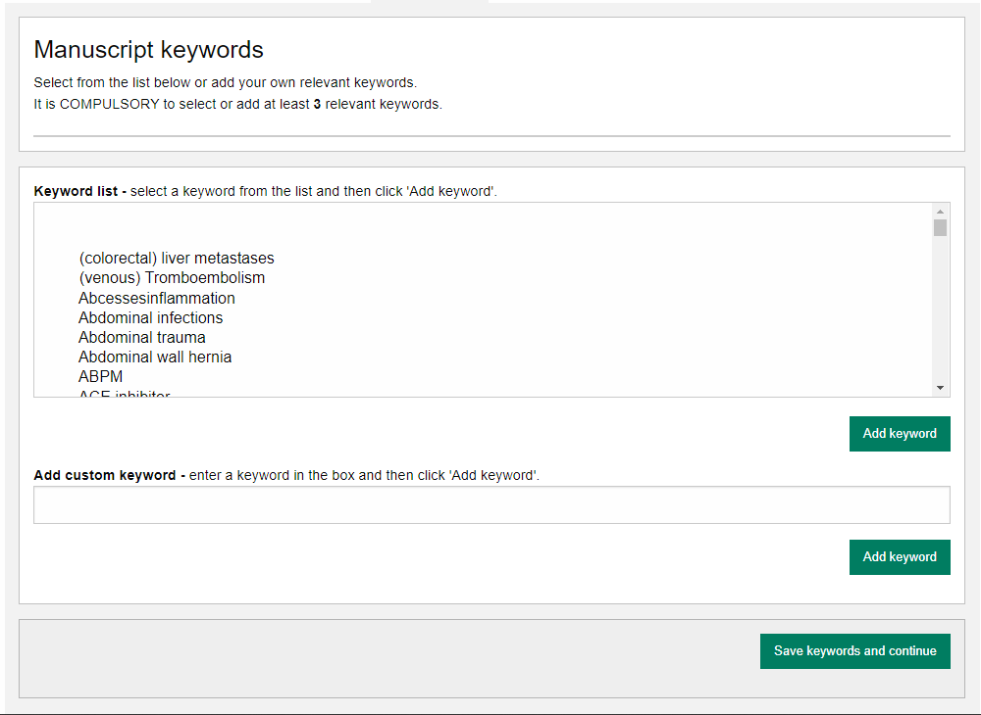
6. Keywords – Add custom keywords
Add the custom Keywords pertinent to your manuscript one-at-a-time
You can add your own or select relevant ones from the list
Click on “Save keywords and Continue”

Slide 13
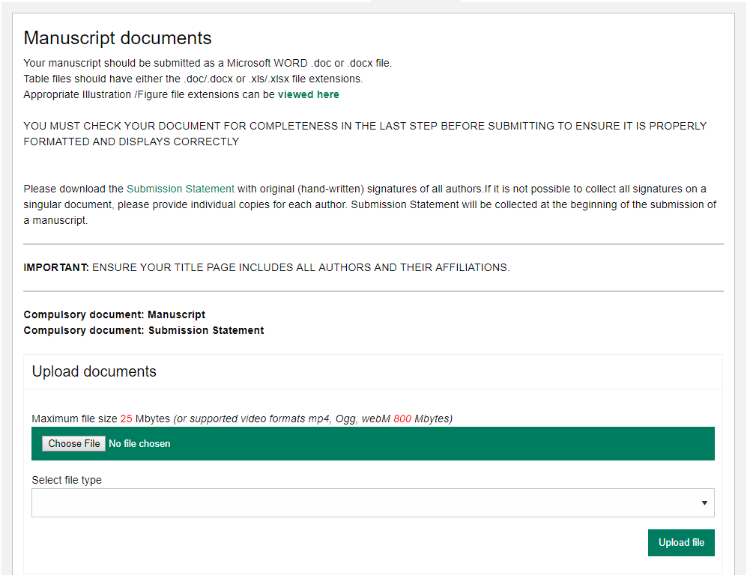
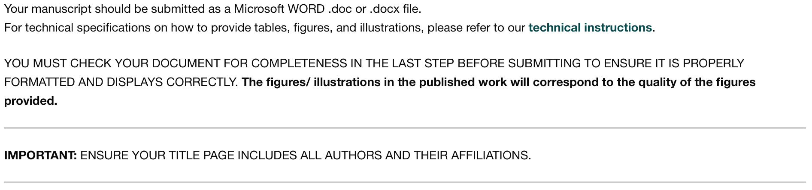
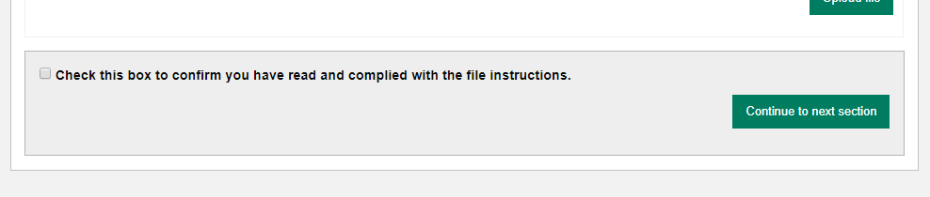
7. Documents – Choose the files
Upload one-at-a-time your manuscript files. Be sure to include the compulsory documents
- Select for each file the corresponding file type
After choosing each file, click on “Upload File”
Check the box when completing the section
Click on “Continue to next section”
1
2
3
1
4
2
3
4

Slide 14
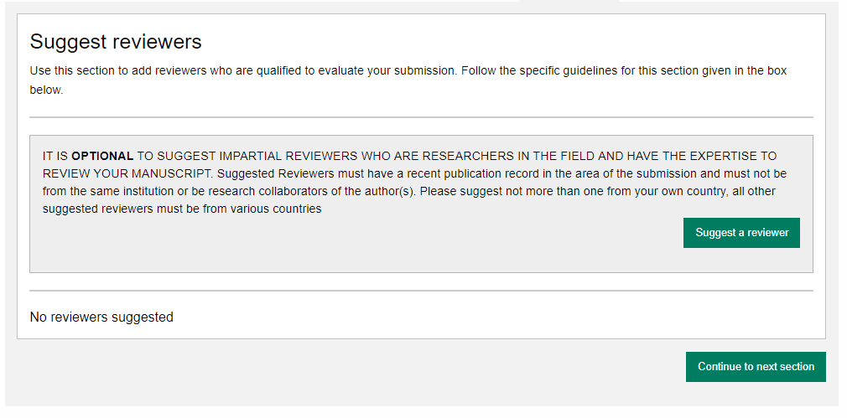
8. Reviewers
Suggested Reviewers are often requested as a standard by the journal’s portal
Click on “Continue to next section”

Slide 15
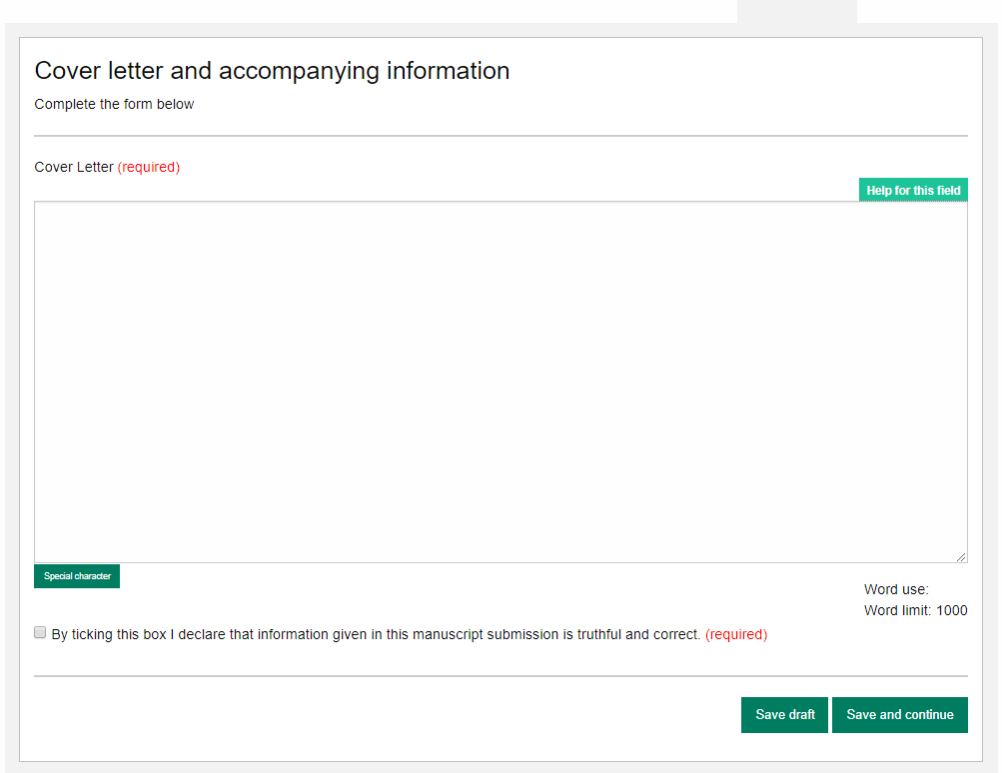
9. Letter – Cover letter and accompanying information
Complete the form by writing the Cover Letter
Check the box when completing the section
Click on “Continue to next section”
1
2
1
3
2
3

Slide 16
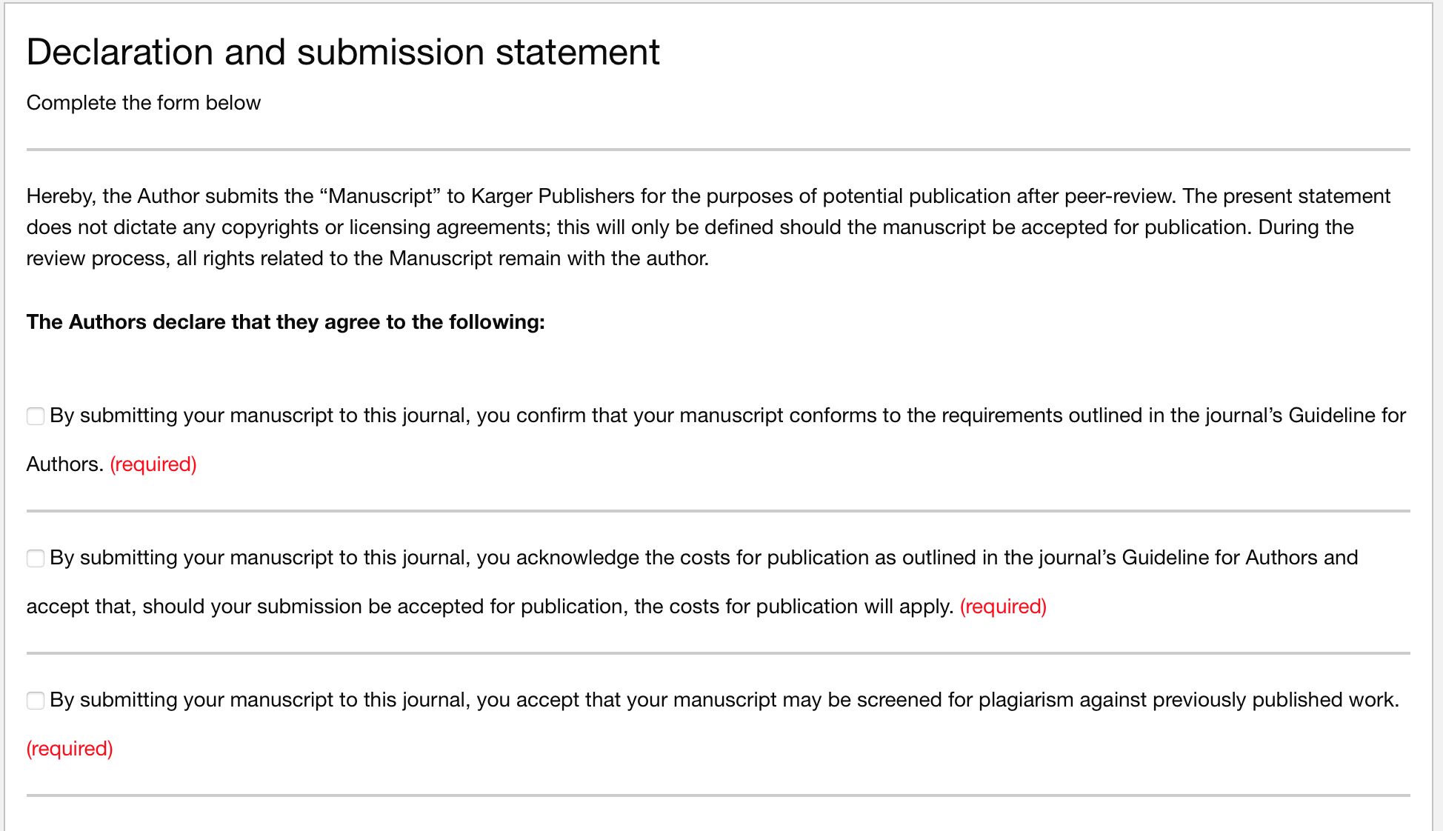
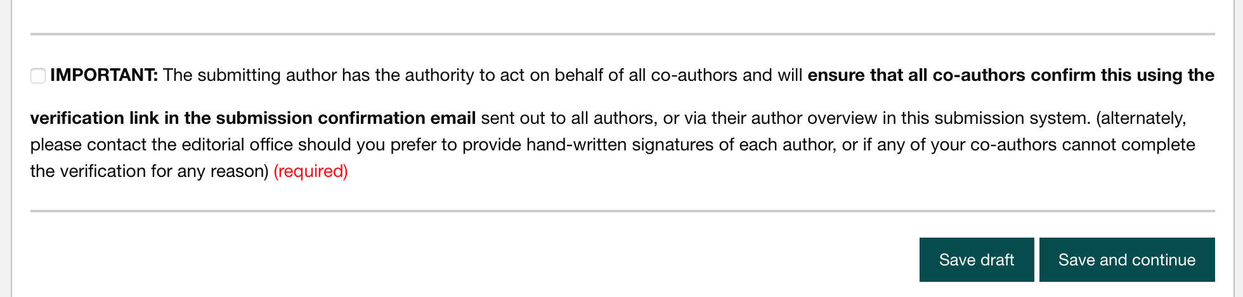
10. Declaration – And submission statement
Read and complete the declaration and submission statement form
Once you declare that you and all co-authors agree, you will be able to click on “Save and continue”
Please note that you will act on behalf of all co-authors and will ensure that all co-authors confirm

Slide 17
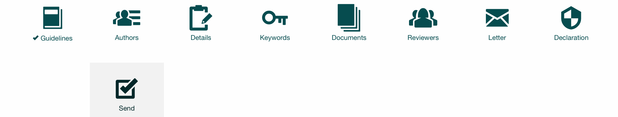
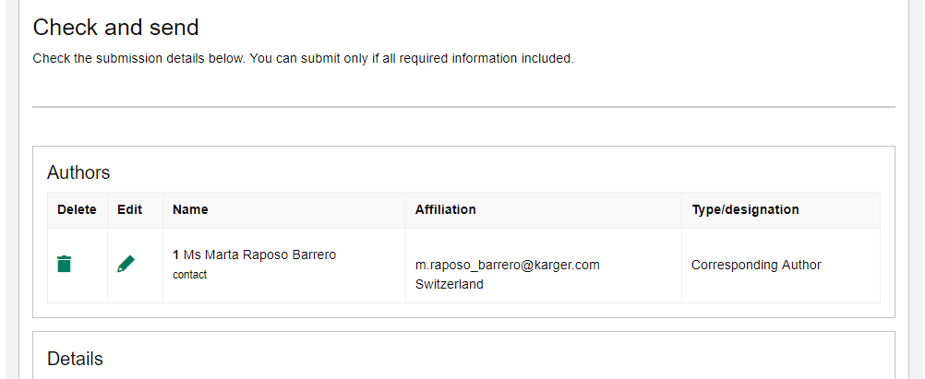
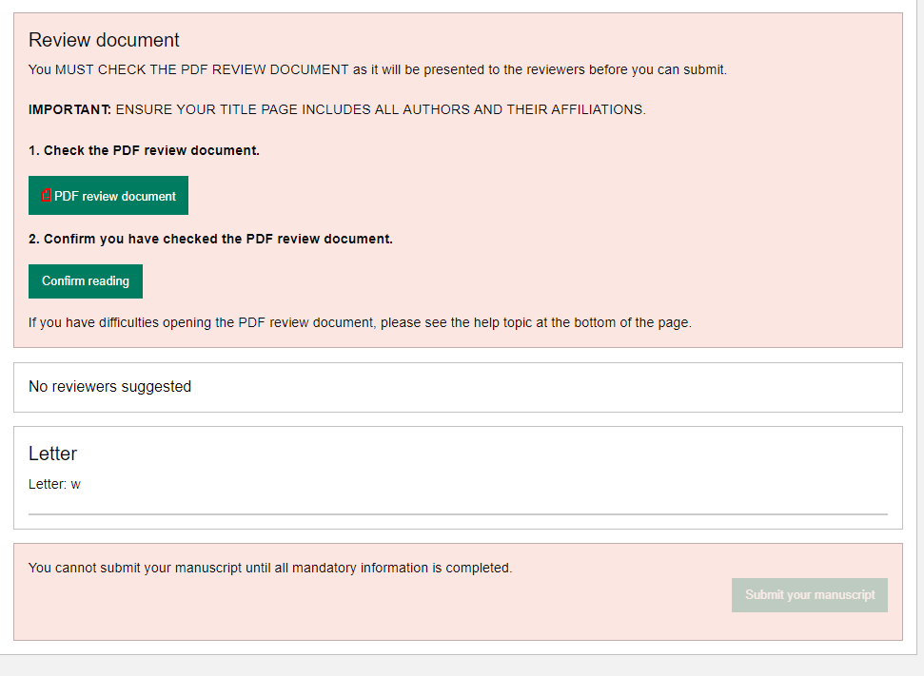

11. Send – Submit your manuscript
Review the submission information
The author will be alerted if any information is missing
In case you have problems submitting your manuscript, please contact the Editorial Office directly
Click on “PDF review document” and check if everything is correct
Click on “Confirm reading”
Click on “Submit your manuscript”
1
1
2
2
3
3

